Slide 1
Handibot Safe Use !

Slide 2
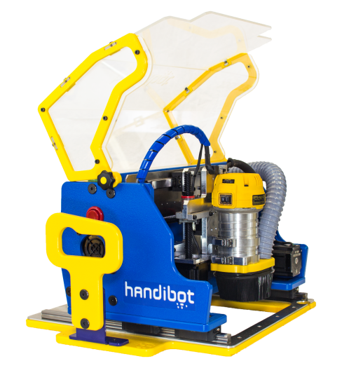
As with any power tool, there are inherent risks to using the Handibot. Following these safety rules can reduce your risk of injury. Because you are probably not familiar with a tool like a Handibot, we suggest you take a careful look at these safety guidelines.
Handibot Safety Introduction
As with any power tool, there are inherent risks to using the Handibot, even though your ability to control the Handibot from a distance provides greater isolation from danger than with a standard power tool. Following these safety rules can reduce your risk of injury.
Follow safe digital-power-tool practices when using a Handibot. Make a habit of including safety in your activities. Read and understand the operator’s manual, tool markings, and the instructions packaged with all accessories before starting any work.

Slide 3
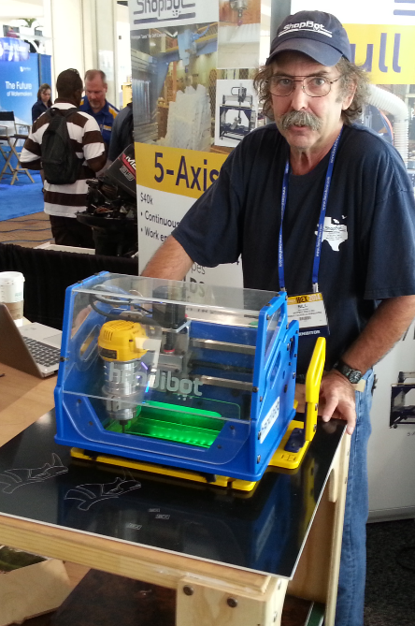
Work Area Safety
Keep your work area clean and well lit. Cluttered benches and dark areas invite accidents. Messy work areas that can cause tripping or loss of balance are particularly dangerous.
Do not operate the Handibot in explosive atmospheres, near flammable liquids, gases, or dust. Power tools create sparks, which may ignite the dust or fumes.
Keep a fire extinguisher in your work area. A spinning bit generates heat. If stalled, the bit could start a fire.
Follow safe digital-power-tool practices when using a Handibot. Make a habit of including safety in your activities. Read and understand the operator’s manual, tool markings, and the instructions packaged with all accessories before starting any work.

Slide 4
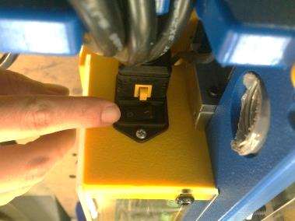
Electrical Safety
Power tool plugs must match the outlet. Never modify the plug in any way. Do not use any adapter plugs with earthed (grounded) power tools.
Do not expose power tools to rain or wet conditions. Water entering a power tool will increase the risk of electric shock.
Check that the cord will not snag and is clear of the cutting operation.
Do not abuse the cord. Never use the cord for carrying or pulling. Keep cord away from heat, oil, sharp edges, or moving parts. Damaged or entangled cords increase the risk of electric shock.
When operating a power tool outdoors, use an extension cord suitable for outdoor use. Use of a cord suitable for outdoor use reduces the risk of electric shock.

Slide 5
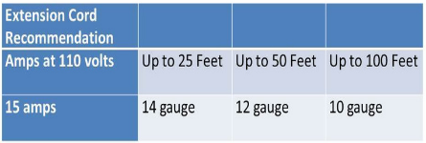
Extension Cord Guidelines
When using the Handibot outside, use an extension cord marked for outdoor use with “W-A” or “W”. These cords are made for outdoor use.
Extension cords with 3-prong grounding plugs that are plugged into 3-prong outlets are required for safe use of the Handibot.
Replace damaged or worn cords immediately.
The wire gauge and length of the extension cord must be able to handle the amp load of the Handibot. Use the chart to determine the necessary wire gauge for your extension cord length.

Slide 6
Personal Safety
Always wear safety goggles or safety glasses with side shields complying with current national standards.
Use the appropriate mask or respirator in dusty work conditions.
Wear proper hearing protection.
Prevent unintentional starting. Ensure that the router switch is in the off position when changing cutter or when tools is not being used.
Dress properly. Do not wear loose clothing, gloves, or jewelry. Keep your hair and clothing away from moving parts. Loose clothes, jewelry, or long hair can be caught in moving parts.
Connect and use dust extraction. Attention to dust collection can reduce dust-related hazards.

Slide 7
- General Power Tool Use and Care -
Do not force a power tool. Use the correct tooling for your application. The correct cutter will do the job better, and safer, at the rate for which it was designed.
Do not use a power tool if the switch does not turn it on and off. Any power tool that cannot be controlled with the switch is dangerous and must be repaired.
Secure and support the workpiece. Use a stable work surface and clamps. Never not hold the work by hand or against your body.
Do not touch the cutter or workpiece immediately after operation. They may be very hot and may burn you. Keep cutting tools sharp and clean. Properly maintained cutting tools with sharp cutting edges are less likely to bind and are easier to control.
Store idle power tools out of the reach of children. Do not allow persons unfamiliar with the power tool or these instructions to operate the power tool. Power tools are dangerous in the hands of untrained users.
Maintain power tools. Check for misalignment or binding of moving parts, breakage of parts and any other condition that may affect the power tool’s operation. If damaged, have the power tool repaired before use. Many accidents are caused by poorly maintained power tools.

Slide 8
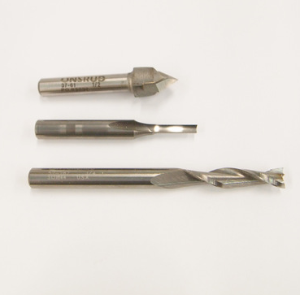
Choose the Right Cutting Tool
Choosing the correct cutting tool or accessory will help you do your job safer and faster and reduce the risk of injury.
Use only those cutters with speeds rated at least as high as the no-load RPM on the tool, 27,000 RPM. The wrong accessory can shatter during use, possibly causing injury.
Never use dull or damaged bits. They are likely to cut poorly or break.
Do handle sharp bits with care.
The correct shank diameter for the standard collet in your tool is 1/4" (6.4 mm). Use the appropriate optional collet for other shank diameters.
Do not use router bits with a diameter in excess of 1/2” (12.7mm) in your Handibot.

Slide 9
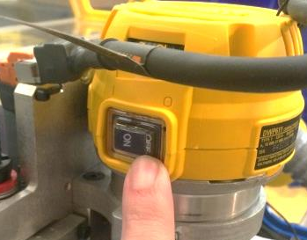
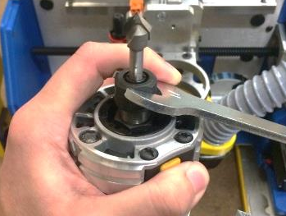
Using/Changing Cutting Tools Safely
Inspect the router bit before each use. NEVER use a bit if the carbide is cracked or appears damaged in any way.
Ensure that Handibot is in the “idle” state (green lights) before changing bits.
The router has its own switch. Set the router switch to OFF before changing bits or making adjustments or changing bits. This will prevent an accidental router start during the bit change operation.
Tighten collet nut securely to prevent the bit from slipping and damaging cutter or material.

Slide 10
Safety and Your Workpiece
The Handibot is designed to be held in place on the workpiece during cutting using its outboard handles.
Secure your workpiece! Small pieces will need to be fixture or clamped. Small cutout parts may need to be “tabbed”.
Do not attempt to hold a workpiece by hand – this is dangerous because you cannot anticipate the next move of the tool.
Make sure the work surface is free from nails and other foreign objects. Cutting into a nail can deflect cutting or shatter the bit.
Your cutter may plunge through your material into the spoilboard below. Never use a hard surface like concrete or stone for your spoilboard as it can damage a cutter or disrupt cutting.
Do not cut steel or other ferrous metals.
Use the appropriate feed rate, depth of cut per pass, and router speed for the material you are cutting. This prevents overloading the motor and improves cut quality.

Slide 11
Safety WHILE Cutting
Never start your Handibot when the bit is touching or within the workpiece. The bit may grab the workpiece and cause loss of control.
If the router does not run smoothly, the bit may be bent or out of balance. Replace the bit immediately.
Maintain a firm grip on the outboard safety handles during operation. The tool may move under cutting forces if released.
Keep hands away from cutting area. Never reach under the workpiece for any reason. Keep the router base firmly in contact with the workpiece when cutting. These precautions will reduce the risk of personal injury.
Never leave the machine running and unattended. A spinning cutter is dangerious as well as being a fire hazard.

Slide 12
Safety AFTER Cutting
Be sure that the motor has stopped completely and before you move the Handibot. If the cutter head is still spinning when the tool is laid down, it could cause injury or damage.
NEVER touch the bit immediately after use. It may be extremely hot.
Store tools and bits with care. Do not drop them or subject them to excessive heat, cold or humidity.
Unplug, clean and store the Handibot in a safe, dry place after use.

Slide 13
TO START …
Plug in and turn on the power to your Handibot
The power cord plugs into receptical on the back of your Handibot.
The On/OFF Switch is just above the receptical.

Slide 14
Log into your Handibot in Acces Point Mode
Using the computer or device that you want to run your tool with, open the WiFi or network manager. *Your device should be a relatively recent WiFi- enabled Windows PC, Mac, Linux PC, iPad, iPhone, or Android smart phone or tablet with Chrome or FireFox browser.
Your Handibot will appear in the list of available networks as “FabMo-xxxxxxx”.
Log into your Handibot’s Access Point Mode link as you would to a network. Use the password: go2fabmo

Slide 15

After your network manager connects to your Handibot it will say something like: Unidentified network, No Internet Acess”.
BUT you now have a direct link right into your Handibot.
Note that at this point your device is no longer connected to the Internet. It’s relationship is exclusively with your Handibot via AP Mode. This is the linkage that we will use to set-up and test your tool. Your tool is always available to you in AP Mode and you will be able to use this linkage in enviroments where wireless networks are not present, such as jobsites or where you want to insure very restriced access.
Later, we’ll take up how to put your Handibot on your local wireless network.

Slide 16
Opening the “Dashboard”
The Dashboard is the gateway to your tool. It is the access to the new FabMo (Digital Fabrication and Motion) platform that is running your Handibot.
Open a Chrome or Firefox Internet browser on your computer, tablet, or phone. In the URL address line enter: 192.168.42.1
The Dashboard controls for your Handibot should appear.
We’re now ready for a little test spin!
Click on the “Quick Launch App” Icon on the Dashboard and follow along with the instruction in the App. These instructions are also available in your Handibot Manual (hardcopy with the tool or available on the Handibot website: www.Handibot.com/docs).

Slide 17
THEN …
Open an internet browser on your computer, tablet, or phone (Chrome or Firefox). And enter the URL 192.168.42.1 {pix entry}
The Dashboard access to your Handibot should appear.
{pix Dashboard}
Follow along in the Quick Launch Manual … and Click on the Quick Launch App in the Dashboard …

